Slide 1
LINQ and LINQ-to-SQL
LINQ Operators and Expressions, Projections, Aggregations, LINQ-to-SQL, Using DataContext
Svetlin Ralchev
svetlin.ralchev@telerik.com
Telerik Corporation
http://blog.ralch.com
www.telerik.com

Slide 2
Table of Contents (1)
Getting ready for LINQ. Which are the new features in .NET Framework 3.5?
Local Variable Type Inference
Object Initializers
Anonymous Types
Extension methods
Lambda Expressions
Live Demo
Notes:
Explain how the presentation will be lectured

Slide 3
Table of Contents (2)
Introduction to LINQ
Data manipulation
Overview of evolution of .NET Framework
LINQ Syntax
LINQ Operators
Explaining LINQ Operators concept
Query Expression Trees
Evaluating of LINQ Operators
Projections, Aggregations and etc.
Live Demo

Slide 4
Table of Contents (3)
Introduction of ORM Technologies
LINQ TO SQL
Overview
LINQ Components
LINQ TO SQL Files
Live Demo – Visual Studio Designer
DataContext Class and CRUD Operations
Live Demo – CRUD Opertions

Slide 5
Getting ready for LINQ
Which are the new features in .NET 3.5?

Slide 6
The new features in .NET 3.5
Local Variable Type Inference
Defined with keyword var for local variables only
Methods cannot have arguments or return types from type var
The keyword signals the compiler to emit a strong type based on the value of the operator on the right side
Integer
var luckyNumber = 7;
var studentName = “Svetlin Ralchev”;
var hireDate = new DateTime(2009, 11, 3);
String
DateTime

Slide 7
The new features in .NET 3.5
Object Initializers
Gives a flexible way to construct objects without implementing additional constructors
Typical initialization of object instance
Trivial Initialization
BankAccount bankAccount = new BankAccount(“BNB”, “485737475”);
bankAccount.Fee = 10;
bankAccount.Balance = 1000;
bankAccount.Currency = Currency.Euro;
Object and Collection Initializers give a easy and faster way for initialization
Initialization with object initializes syntax
Class variable = new Class { Property1 = value1, etc};
BankAccoun bankAccount = new BankAccount { Bank = “BNB”, Number = “485737475”, Fee = 10, Balance = 1000, Currency = Currency.Euro };

Slide 8
The new features in .NET 3.5
Anonymous types
Classes without the “typed” class definition. Think of this use of anonymous types as defining an inline class without all of the typing
Composite anonymous types require member declarators
Anonymous types bring us possibility to create a temporary type depends on context needs
var motorcycle = new { Name=”Honda” [, declaratory=value, ...] }
var student = new { Name = “Svetlin Ralchev”, Age = 24 };
string name = student.Name;
int age = student.Age;

Slide 9
The new features in .NET 3.5
Extension methods
Enable you to "add" methods to existing types without creating a new derived type, recompiling, or otherwise modifying the original type
Special kind of static methods, that are called as instance methods
public static class Utility
{ public static string Reverse(this string input) {
...
}
}
Extensions methods improve the readability of the code
string carName = “civic";
string reversedCarName = carName.Reverse();

Slide 10
The new features in .NET 3.5
Lambda Expressions
They are natural result form the evolution of anonymous delegates
Syntax
Typical implementation of anonymous delegate
delegate T ReturnAction<T>(T item);
// Implementation using anonymous delegates
ReturnAction<int> doubleAmount = delegate(int number)
{
return number * 2;
};
Typical implementation of lambda expression
ReturnAction<int> doubleAmount = number => number * 2;
int result = doubleAmount(5);
The left side (of the =>) represents the arguments to the function and the right side is the function body.

Slide 11
Live Demo
The new features in .NET Framework 3.5

Slide 12
Introduction in LINQ
What is LINQ?

Slide 13
Data manipulation
As software developers we spent a lot of time to obtain and manipulate data
Data can be stored in
Collections
Databases
XML documents
etc...
In .NET 3.5 we can use unified approach to data manipulation

Slide 14

The evolution of .NET
Rapid way for manipulation with any kind of data
C# 3.0
LINQ
C# 2.0
Generics
C# 1.0
Components on a Managed Runtime

Slide 15
What is LINQ?
LINQ = Language INTegrated Query
The LINQ API is an attempt to provide a consistent, symmetrical manner
In which programmers can obtain and manipulate "data" in the broad sense of the term
Brings the power of SQL Queries to any kind of collections
Natively supported in C# and Visual Basic since .NET Framework 3.5

Slide 16




LINQ TO …
VB
C#
Others…
.NET Language-Integrated Query
LINQ enabled data sources
LINQ enabled ADO.NET
LINQ
To Objects
LINQ
To DataSets
LINQ
To SQL
LINQ
To Entities
LINQ
To XML
<book>
<title/>
<author/>
<price/>
</book>
Objects
Relational
XML

Slide 17
LINQ Syntax
Declarative Syntax (SQL-like syntax)
int[] numbers = new int[] { 5, 18, 97, 92, 81, 60 };
var even = from num in numbers
where num % 2 == 0
select num;
Extension Methods Syntax
var even = numbers.Where(x => x % 2 == 0)
.Select(x => x);

Slide 18
LINQ Syntax (2)
Each SQL-like syntax usage is transformed by CLR to sequences of extension methods execution
from c in customers
where c.City == “Sofia"
select new { c.Name, c.Phone };
customers
.Where(c => c.City == “Sofia")
.Select(c => new { c.Name, c.Phone });

Slide 19
LINQ Operators
Projection, Aggregation Operators and etc.

Slide 20
LINQ Operators
The Standard Query Operators are extension methods
It is preferable to call them on a variable of type IEnumerable<T> as the extension method syntax
You can pass a variable of type IEnumerable<T> as the first argument

Slide 21
LINQ Operators (2)
Most of the Standard Query Operators are extension methods in the System.Linq.Enumerable static class
Prototyped with an IEnumerable<T> as their first argument
var allStudentNames = from student in students
select student.Name;
var allStudentNames = students.Select(student => student.Name);
public static IEnumerable<TResult> Select<TSource, TResult>(this IEnumerable<TSource> source, Func<TSource, TResult> selector);

Slide 22
Query Expression Trees
In LINQ, expression trees are used to represent structured queries that target sources of data that implement IQueryable<T>
Expression trees represent language-level code in the form of data.
Each node in the expression tree represents an expression

Slide 23
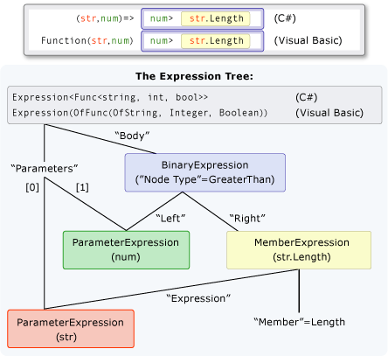
Query Expression Trees
Expression<Func<string, int, bool> = (str, num) => num > str.Length;

Slide 24
Expression Tree Benefits
Efficient way of analysis of query operators
Optimizing multiple nested or complex queries to produce better performance
Combining multiple queries into very efficient single one

Slide 25
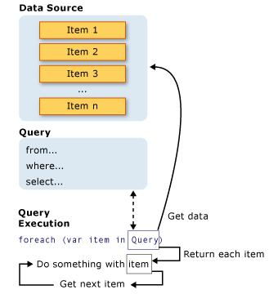
LINQ Operators Evaluation
Can be used to query and to transform data from any LINQ-enabled data source
All LINQ query operations consist of three distinct actions:
Obtain the data source
Create the expression tree of the query
Execute the query

Slide 26
LINQ Operator Evaluation (2)
A query is not executed until
You iterate over the result of the query
You try to access any of the elements in the result set
LINQ Operator Types
Deferred evaluation (lazy loading) - When you query for an object, you actually retrieve only the object you requested. The related objects are not automatically fetched at the same time.
Eager evaluation (non-deferred loading) -When you query for an object, you actually retrieve all related objects if they are not fetched before that.

Slide 27
Deferred LINQ Operators
Join
OfType
OrderBy
OrderByDescending
Range
Repeat
Reverse
Select
SelectMany
Skip
SkipWhile
Take
AsEnumerable
AsQueryable
Cast
Concat
DefaultIfEmpty
Distinct
Empty
Except
GroupBy
GroupJoin
Intersect

Slide 28
Non Deferred LINQ Operators
Aggregate
All
Any
Average
Contains
Count
ElementAt
ElementAtOrDefault
First
FirstOrDefault
Last
LastOrDefault
LongCount
Max
Min
SequenceEqual
Single
SingleOrDefault
Sum
ToArray
ToDictionary
ToList
ToLookup

Slide 29
Projection Operators (1)
Deferred operations which projects each element of a sequence into a new form.
Select Operator
- Projects single values that are based on a transform function
SQL-like declarative syntax
var squares = from num in numbers
select num * num;
Extension method equivalent
var squares = numbers.Select(x = > x * x);

Slide 30
Projection Operators (2)
SelectMany Operator
- Projects collections of values into a new collection containing all values
int[] numbers = new int[] { 5, 4, 7, 6, 4, 9 };
int[] powers = new int[] { 0, 1, 2, 3, 4, 5 };
SQL-like declarative syntax
var result = from num in numbers
from pow in powers
select Math.Pow(num, pow);
Extension method equivalent
var result = numbers.SelectMany(num => powers.Select(pow => Math.Pow(num, pow)));

Slide 31
Filtering Operators
Conditional operator that filters the elements returned in a result set depending on defined conditions
Where Operator
SQL-like declarative syntax
var positiveEven = from num in numbers
where num > 0 &&
num % 2 == 0
select num;
Extension method equivalent
var positiveEven =
numbers.Where(x=>x > 0 && x % 2 == 0);

Slide 32
Ordering Operators
Deferred operations which sorts the result set by specified properties
OrderBy and OrderByDescending Operator
SQL-like declarative syntax
var sortedNumbers = from num in numbers
orderby num descending
select num;
Extension method equivalent
var sortedNumbers = numbers.OrderByDescending(x => x);
Reverse Operator
var reversedOrderOfNumbers = numbers.Reverse();

Slide 33
Grouping Operators
Deferred operation which organize the source in logical groups based on the value of specified property
GroupBy Operator
SQL-like declarative syntax
string[] words = { "blueberry", "chimpanzee", "abacus", "banana", "apple", "cheese" };
var wordGroups = from word in words
group word by word[0] into groupedWords
select new { FirstLetter = groupedWords.Key, Words = groupedWords };
Extension method equivalent
var result = words.GroupBy(word => word[0]).Select(groupedWords => new { FirstLetter = groupedWords.Key, Words = groupedWords });

Slide 34
Aggregation Operators
Aggregation operations compute a single value from a collection of values.
Count Operator
Sum Operator
Min and Max Operator
Average Operator
Aggregate Operator
Extension method syntax
var query = numbers.Aggregate( (accumulator, number) => accumulator + number);
var query = numbers.Sum();

Slide 35
Partitioning Operators
Deferred operations which are used to partition collections into two parts and then return one of the parts.
Skip and SkipWhile Operator
Take and TakeWhile Operator
Extension method syntax
int page = 2;
const int pageSize = 5;
var query = students.Skip((page - 1)*pageSize).Take(pageSize);

Slide 36
Conversion Operators
Non Deferred operations which convert the result set to specified enumerable type and force evaluation of the query
ToArray
ToDictionary
ToList
Extension method syntax
List<int> numberSquares = numbers.Select(p => p * p).ToList();

Slide 37
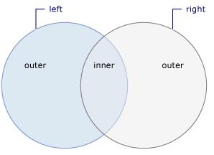
Join Operator (1)
Action of relating or associating one data source object with a second data source object
The two data source objects are associated through a common value or attribute

Slide 38
Join Operator (2)
Deferred operation which joins two or more source into one source depending on their relation
List<Customer> customers = new List<Customer> {
new Customer{ ID=1, CompanyName=”Telerik” },
new Customer{ ID=2, CompanyName=”Microsoft” },
new Customer{ ID=3, CompanyName=”Snowflake” }};
List<Order> orders = new List<Order> {
new Order { ID=1, CustomerID=1, Item=”RadControls” },
new Order { ID=2, CustomerID=1, Item=”MS Office 2k” },
new Order { ID=3, CustomerID=2, Item=”ORM Exporter” }};
var query = from customer in customers
join order in orders
on customer.ID equals order.CustomerID
select new { Name = customer.CompanyName,
Item = order.Item };

Slide 39
Live Demo
Standard LINQ Operators

Slide 40
Introduction to ORM
Object-relation mapping technologies

Slide 41
ORM Technologies (1)
Object-relational mapping is a programming technique for converting data
Between incompatible type systems
In relational databases and object-oriented programming languages
This creates a “virtual object database“
Which can be used from within the programming language

Slide 42
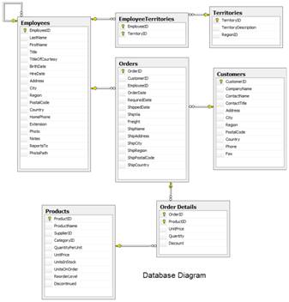
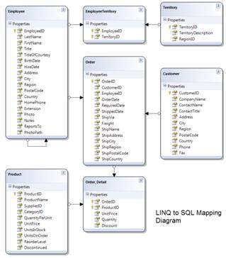
ORM Technologies (2)
Database and LINQ to SQL mapping diagram for a subset of the Northwind database.
Data Base Schema
ORM Entities

Slide 43
ORM Technologies (3)
Data management tasks in object-oriented programming are typically implemented
By manipulating objects, which are almost always non-scalar values
An ORM implementation should systematically and predictably choose
Which tables to use
And generate the necessary SQL

Slide 44
ORM Advantages
Object-relational mapping advantages
Performance
Linear scalability
Manageability of the CRUD operations for complex relationships
Application maintainability
Flexibility

Slide 45
LINQ TO SQL
Object Relation Mapping Framework

Slide 46
Overview of LIQN TO SQL (1)
LINQ to SQL is a component of .NET Framework version 3.0
Provides a run-time infrastructure for managing relational data as objects
The data model of a relational database is mapped to an object model
Expressed in the programming language of the developer (data base tables are represented as classes called entities)

Slide 47
Overview of LINQ TO SQL (2)
LINQ to SQL is an application programming interface (API) on the top of ADO.NET and LINQ
For working with SQL Server databases
LINQ to SQL is Microsoft’s entry-level LINQ-enabled ORM implementation for SQL Server
LINQ to SQL only works with SQL Server or SQL Express

Slide 48
LINQ TO SQL Features
CRUD (Create, Read, Update and Delete) Operations over data base model
Creating or deleting databases or tables
Map Tables, Views, Stored Procedures and SQL Functions
Create compiled queries - used when executing same parameterized query multiple times

Slide 49
LINQ TO SQL Lifecycle
When the application runs
LINQ to SQL translates into SQL the language-integrated queries in the object model
And sends them to the database for execution
When the database returns the results
LINQ to SQL translates them back to objects
That we can work with in our own programming language
LINQ Operators are executed over variable of type IQueryable<T>, then at compile time a Query Expression Tree is emitted

Slide 50
LINQ Components
The DataContext
The class that establishes a connection to a database
It provides several services that provide identity tracking, change tracking, and change processing
Entity Classes
Each database table is typically mapped to a single entity class

Slide 51
LINQ Components (2)
Associations
An association is the term used to designate a primary key to foreign key relationship between two entity classes
Concurrency Conflict Detection
One of the valuable services that the DataContext is performing for you is change processing
Concurrency Conflict Resolution
Resolve the concurrency conflict

Slide 52
LINQ TO SQL Files (1)
DBML – Data Base Markup Language
DBML is an XML file that has a connection string, provider information, and metadata mapping that represents the database schema.
DBML.cs file contains entities that represent the data base tables and inherited implementation of DataContext class

Slide 53
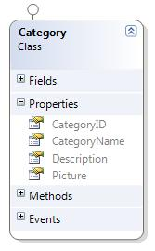
LINQ TO SQL Files (2)
DBML Files of table Category from Northwind
DBML Declaration of Category table
<Table Name="dbo.Categories" Member="Categories">
<Type Name="Category">
<Column Name="CategoryID" Type="System.Int32" DbType="Int NOT NULL IDENTITY" IsPrimaryKey="true" IsDbGenerated="true" CanBeNull="false" />
<Column Name="CategoryName" Type="System.String" DbType="NVarChar(15) NOT NULL" CanBeNull="false" />
<Column Name="Description" Type="System.String" DbType="NText" CanBeNull="true" UpdateCheck="Never" />
<Column Name="Picture" Type="System.Data.Linq.Binary" DbType="Image" CanBeNull="true" UpdateCheck="Never" />
</Type>
</Table>
Category Entity Class

Slide 54
Live Demo
Visual Studio LINQ TO SQL Designer

Slide 55
DataContext Class
DataContext class generated by designer provides you:
Ability to manipulate SQL data though entity classes (read, modify, delete, insert)
Easily navigate through tables constraints
Converting LINQ query into native SQL query
Create new databases from current schema

Slide 56
Using DataContext Class
First create instance of DataContext
In constructor you can set connection and mapping source
DataContext properties
Connection
CommandTimeout
Log – prints generated SQL queries to TextReader
Transaction – set local transaction
All Entity classes (tables) as properties
NorthwindDataContext db = new NorthwindDataContext();

Slide 57
Creating data
Performed by using InsertOnSubmit or InsertAllOnSubmit() to the current entity class
SubmitChanges() method call is required to perform insert action
// create new order object
Order customOrder = new Order()
{ OrderDate = DateTime.Now,
ShipName = "Titanic",
ShippedDate = new DateTime(1912, 4, 15),
ShipCity = "Bottom Of The Ocean“
};
// mark to be insert on the next submit
context.Orders.InsertOnSubmit(customOrder);
context.SubmitChanges();

Slide 58
Reading data
Reading Data From LINQ To SQL – as simple as reading from collection:
db.ObjectTrackingEnabled = false;
var customers = from c in db.Customers where c.City=="London"
select c;
Customers Property Implementation
public System.Data.Linq.Table<Customer> Customers
{
get { return this.GetTable<Customer>(); }
}
Setting ObjectTrackingEnabled property to false
improves performance by setting DataContext to read-only mode

Slide 59
Reading data with SQL Query
You can execute SQL query through DataContext and convert the result to the corresponding class
Performed with ExecuteQuery() method
var customers = db.ExecuteQuery<Customer>("select * from Customers where City='London'");
foreach (var item in customers)
{
Console.WriteLine(String.Format("Company:{0}, Phone:{1}",item.CompanyName, item.Phone));
}

Slide 60
Update data
DataContext gives you ability to modify cells of different records in db by changing object properties
After making changes SubmitChanges() method must be called to make changes to the database
Order order = context.Orders.First();
order.OrderDate = DateTime.Now;
context.SubmitChanges();

Slide 61
Delete data
Performed by using DeleteOnSubmit or DeleteAllOnSubmit() to the current entity class
SubmitChanges() method call is required to perform delete action
Order order = context.Orders.First();
//mark for delete on the next sumbit
context.Orders.DeleteOnSubmit(order);
context.SubmitChanges();

Slide 62
Live Demo
CRUD Operations with LINQ TO SQL

Slide 63
LINQ and LINQ-to-SQL

Slide 64
References
MSDN: http://msdn.microsoft.com/en-us/
WPF FMI Course: http://www.dotnet.graduate-bg.com/CourseMaterials/Materials.aspx
Books:
LINQ Unleashed for C# by Paul Kimmel
Essential LINQ by Charlie Calvert and Dinesh Kulkarni
Pro LINQ by Joseph C. Rattz

